Slide 1
Responsive Web Design
Compiled by: Athoug Alsoughayer

Slide 2
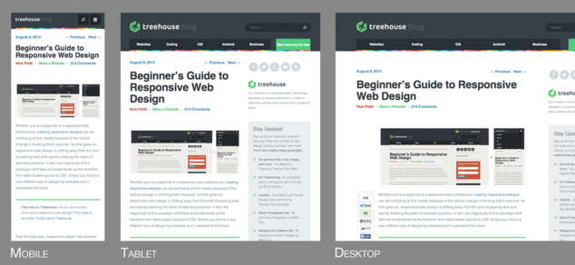
What is Responsive Web Design?
Responsive web design is a technique for building websites that work on mobile devices, tablets, and desktop screens. Not long ago, websites were typically designed specifically for laptop and desktop screen resolutions. This worked fine until the advent of web capable smart phones and tablets. Web designers approached the new challenge with a myriad of solutions. One of the solutions is the basic principles of responsive web design that Ethan wrote in his article

Slide 3

Why Use Responsive Web Design?
https://www.youtube.com/watch?v=iSY38POjLYc

Slide 4
There’s a myriad of web capable devices already available, and there are new form factors every day, so it’s impossible to target each individual screen. Instead, it’s better to let the website respond to its environment and adapt fluidly.
This involves three main principles that come together to form the whole that is responsive design. They are:
Fluid Grids
Fluid Images
Media Queries

Slide 5
Fluid Grids
Websites have been defined in terms of pixels. This is an idea that was carried over from the print industry, where a magazine or a newspaper was always going to be the same fixed size. For better or worse, this is not how websites are displayed. Rather, a website might appear in a large format like on a television, or on a very small screen like a smartphone (or even a smartwatch). For this reason, responsive websites are built with relative units like percentages, rather than fixed units like pixels.
There’s a simple math formula that can help you transition to using percentages. It looks like this:
target / context = result

Slide 6
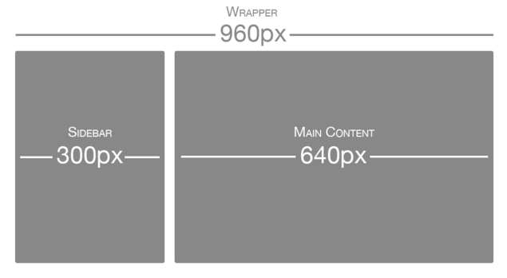
let’s say that you have a two column layout inside of your 960px wide site. The left column is a sidebar that’s 300px wide and the right column is the main content area at 640px wide. You also want 20px of margin between the two columns. Here’s an image illustrating what that might look like:
Using the same formula, each part of the site would have the following values:
Sidebar: 300px / 960px = 31.25%
Main Content: 640px / 960px = 66.66667%
Margin: 20px / 960px = 2.08334%

Slide 7
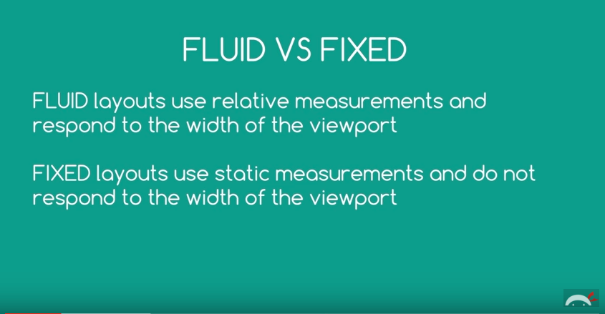
Fluid Layouts
https://www.youtube.com/watch?v=0gBnRll5XgA

Slide 8
Fluid Images
There have been many advances in responsive images, but the core idea is that images should be able to shrink within the confines of a fluid grid. This can be done very simply with a single line of CSS code:
This will tell the browser that any images should only ever be as large as their pixel value, which will ensure that the image is never stretched or pixelated. However, if they’re nested inside a parent container that’s smaller than their pixel value, then the image should shrink. So for example, if an image with a width of 800px is placed inside a container that’s only 600px wide, the image will also shrink to be 600px wide. The height will be calculated automatically and will maintain the original aspect ratio.

Slide 9
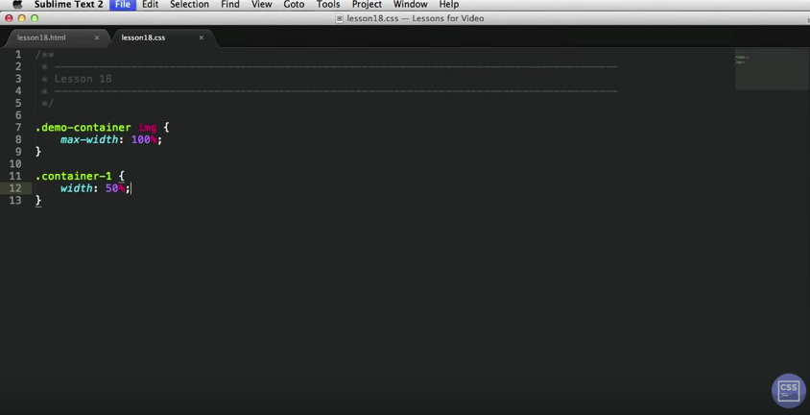
Fluid Images
https://www.youtube.com/watch?v=poYubm4WeL4

Slide 10
Media Queries
Media queries are a CSS technology that have been available in browsers for several years now, and they’re a core component of responsive design. Media queries allow CSS to only be applied when specific conditions are met. For example, you could write a media query that will only applies CSS if the browser reaches a specific width. That means that when a design is too large or too small, a media query can be used to detect the site width and serve CSS that appropriately rearranges the site’s content.
Using the previous two column layout as an example, let’s say that we want to move the sidebar up to the top on mobile screen sizes.The media query to do that might look like this:

Slide 11
Using a series of media queries like this, we can work our way up towards larger resolutions. The set of pixel widths I recommend targeting are as follows:
320px (Mobile)
480px (Tablet)
600px (Tablet)
768px (Tablet)
900px (Desktop)
1200px (Desktop)

Slide 12
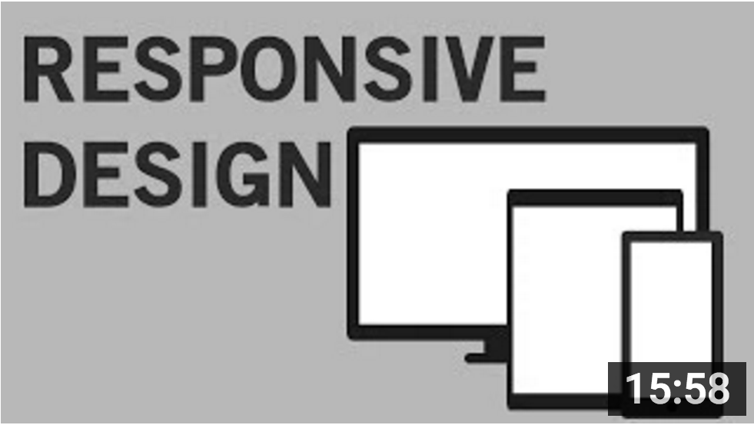
Media Queries
https://www.youtube.com/watch?v=fA1NW-T1QXc

Slide 13
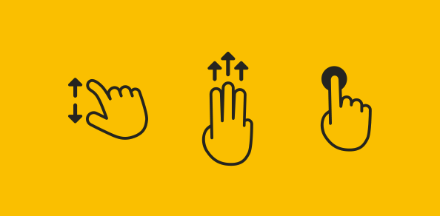
Responsive Web Design as We Know It
Here are some of the most widely accepted aspects of current RWD as we know it.
Supporting Multiple Display Types
We all know we need to cater for a list of possible display resolutions as long as your arm, multiple pixel densities and various viewport sizes.
Supporting Multiple Input Mechanisms
We have to cater for multiple input methods, e.g. saying goodbye to mouse hover dependence and making UI elements touch friendly.

Slide 14
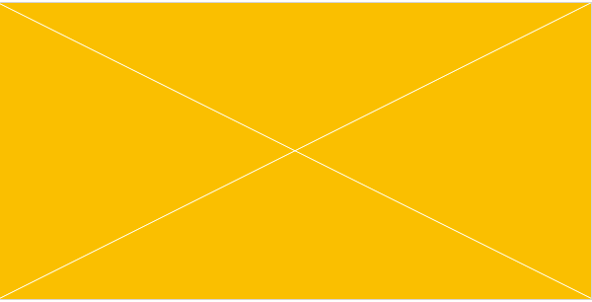
Using Media Queries and Breakpoints
We need to utilize Media Queries to deploy adjustments to our layouts as and when they’re needed.
We know breakpoints should be placed not at predetermined widths, but rather at the point at which the design “breaks” and warrants adjustment.
Display Media Flexibly
Our images need to be fluidly sized so they’re neither too big nor too small at various display sizes.
Other media, such as video and audio players, also need to behave in the same fluid way.

Slide 15
Use the Viewport Meta Tag
We have to include a viewport meta tag (and, looking forward, the CSS equivalent) so our layouts behave how we expect them to:

Slide 16
In Conclusion
Because technology is always changing by the minute, it is extremely important for us to remain focused on the underlying goals of responsive web design, and not get too attached to any one way of doing things. In this way we ensure we’re always open to discovering new ways to create better experiences for the people who use our sites.

